Slide 1
Rapid-Safe Battery Charging: Controls & Learning with Electrochemical Models – Mid Year Update
University of California, Berkeley
Energy, Controls, and Applications Lab (eCAL)
07/24/2018

Slide 2
Project Overview
Task 1: Optimize Charge w/ Reduced EChem Model
Task 2: Refinement w/ Simulation Based Reinforcement Learning
Task 3: Battery-in-the-Loop Experiments

Slide 3
Overview of Key Results – To Date
Task 1: Optimize Charge w/ Reduced EChem Model
Optimal Charging Literature Review (Complete)
Optimal Charging Preliminary Results – UCB Parameters (Complete)
Reduced Order Model Validation – LG Chem Parameters (Complete)
Optimal Charging Results – LG Chem Parameters (In Progress)
Task 2: Refinement w/ Simulation Based Reinforcement Learning
Reinforcement Learning Literature Review (In Progress)
Full Order Model Validation – LG Chem Parameters (In Progress)

Slide 4
Task 1: Optimize Charge w/ Reduced EChem Model

Slide 5
Optimal Charging Literature Review – Overview
Objective: Survey recent fast charging literature to identify novel modeling and optimization techniques which yielded unconventional results (e.g. abnormal current profile)
Method: Searched GoogleScholar, ResearchGate, and relevant journals for published works. Categorized each paper -- as much as possible -- by model, optimization method, objective function, constraints, and what protocol, if any, the current and voltage profiles resembled (e.g. ~MCC-CV).
Began with 29 potentially relevant papers. Found 7 with interesting, pertinent results. Link to Literature Review Spreadsheet.

Slide 6
Optimal Charging Literature Review – Results
Findings: There are two main objective functions in the literature: minimize time to reach SOC and maximize SOC in fixed time. These are often combined with temperature rise or SOH/capacity fade to form multi-objective functions.
Sample Entry:
Title | Author | Year | Model | Optimization Method | Objective Function | Constraints
Electrochemical Estimation and Control for Lithium-Ion Battery Health-Aware Fast Charging | Zou, C. | 2017 | SPMet | (1) Moving Horizon Estimate (2) LTV-MPC | Minimize charging time, with SOH cost function | SOC, T, electrochemical, side reactions
TAKEAWAY: Although there were a variety of modeling and optimization techniques, there were no new groundbreaking control methods found in the literature review.

Slide 7
Optimal Charging Preliminary Results – UCB Parameters
Minimum time to reach desired SOC from initial SOC subject to operating constraints
Parameter Set: LFP* (UCB Parameters for A123 Systems 26650 2.3Ah Cell)
Models: SPM**, SPMe**, and SPMeT**
Initial Conditions: 25ºC, 25% SOC
Terminal Condition: 75% SOC
Constraints: Current, Solid and Electrolyte Concentration, Temperature
* This parameter set is used for demonstration purposes
** SPM (Single Particle Model), SPMe (Single Particle Model with Electrolyte Dynamics), SPMeT (Single Particle Model with Electrolyte and Temperature Dynamics)

Slide 8
Optimal Charging Preliminary Results – UCB Parameters
Model Based Charge Profiles
SPM: 2 Stage with 5.1050min charge time*
Stage 1: Constant Current
Stage 2: Constant Surface Concentration
SPMe: 3 Stage with 5.7558min charge time
Stage 1: Constant Current
Stage 2: Constant Electrolyte Concentration
Stage 3: Constant Surface Concentration
SPMeT: 3 Stage with 4.5984min charge time
Stage 1: Constant Current
Stage 2: Constant Electrolyte Concentration
Stage 3: Constant Surface Concentration
*Faster charge time achieved for SPM due to lack of electrolyte dynamics whose constraint becomes active when using the SPMe and SPMeT. An active constraint corresponds to a decrease in allowable current and therefore an increase in overall charge time. For a practical fast charging application, electrolyte and temperature dynamics are important and necessary to consider from a model based perspective.

Slide 9

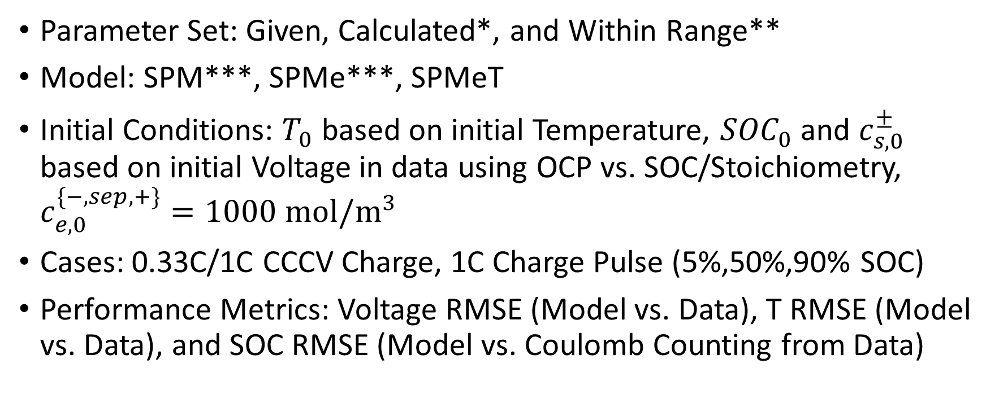
Reduced Order Model Validation – LGC Parameters
Parameter Set: Given, Calculated*, and Within Range**
Model: SPM***, SPMe***, SPMeT
Initial Conditions: $T_{0}$ based on initial Temperature, ${SOC}_{0}$ and $c_{s,0}^{±}$ based on initial Voltage in data using OCP vs. SOC/Stoichiometry, $c_{e,0}^{\{−,sep,+\}}=1000 mol/m^{3}$
Cases: 0.33C/1C CCCV Charge, 1C Charge Pulse (5%,50%,90% SOC)
Performance Metrics: Voltage RMSE (Model vs. Data), T RMSE (Model vs. Data), and SOC RMSE (Model vs. Coulomb Counting from Data)
*Calculated: ${η_{Li}}_{s},ε_{s}^{±}$
**Within Range: $ε_{e}^{±}, τ$ (when electrolyte dynamics are included), $R_{th},T_{amb}$ (when thermal dynamics are included)
***Temperature: SPM and SPMe with Measured Temperature as Input

Slide 10
SPMeT Model Validation – 1C CCCV Charge (25ºC) – LGC Parameters
RMSE_V=0.0389V, RMSE_T=0.7279ºC
RMSE_SOC=2.6514e-04 (0.026514%)

Slide 11
Optimal Charging Results*** – LGC Parameters
Minimum time to reach desired SOC from initial SOC subject to operating constraints
Parameter Set: LGC*
Models: SPMeT
Initial Conditions: ~25ºC, ~5% SOC
Terminal Condition: 80% SOC
Constraints:
Current: 0 to 5C** (Max Current >2C - In Progress)***
Temperature: 25ºC to 60ºC
Solid Concentration: 0% to 100% Cell SOC Stoichiometric Window
Electrolyte Concentration: 0mol/m³ to 5000mol/m³
* The parameter set is based on given, calculated, and within range parameters for the LG Chem cell under study
** 1C current as defined in current data
*** In Progress

Slide 12
Optimal Charging Results – 2C (25ºC) - LGC Parameters
Charge Time = 23.79min
Optimal Profile = Constant Current

Slide 13
Task 2: Refinement w/ Simulation Based Reinforcement Learning

Slide 14
Reinforcement Learning Literature Review* – Overview
Objective: Survey model based and model free reinforcement learning literature to identify algorithms used for energy system applications
Method: Searching GoogleScholar, ResearchGate, and relevant journals for published works. Categorized each paper -- as much as possible -- by application, algorithm, objective function, optimization variables, and constraints.
Title | Method | Application | Objective Function | Unique ECT vars | Key Findings
Wahl et. al 2014 | ADP | Far trajectory planning | HDP: min LSQ on critic error | - | Precise w/in 7% Big comp decrease
Powell 2012 | ADP | Grid energy storage | Min LSQ (HDP), KGCP | - | Direct policy > min LSQ
Dong et. al 2011 | DP | BESS peak shaving | Min variance of load + BESS output | #Discharge cycles, DOD constraints | N/A
Zhang 2015 | ADP | EV charging stations | TSADP: (1) LP (2) Monte Carlo ADP | - | 2.5% better than ADP on average
Li 2018 | ADP | ACC in HEV | Min LSQ (HDP), gradient descent | - | ACC reduces fuel consumption by 4.11%
* In Progress - Link to Literature Review Spreadsheet

Slide 15

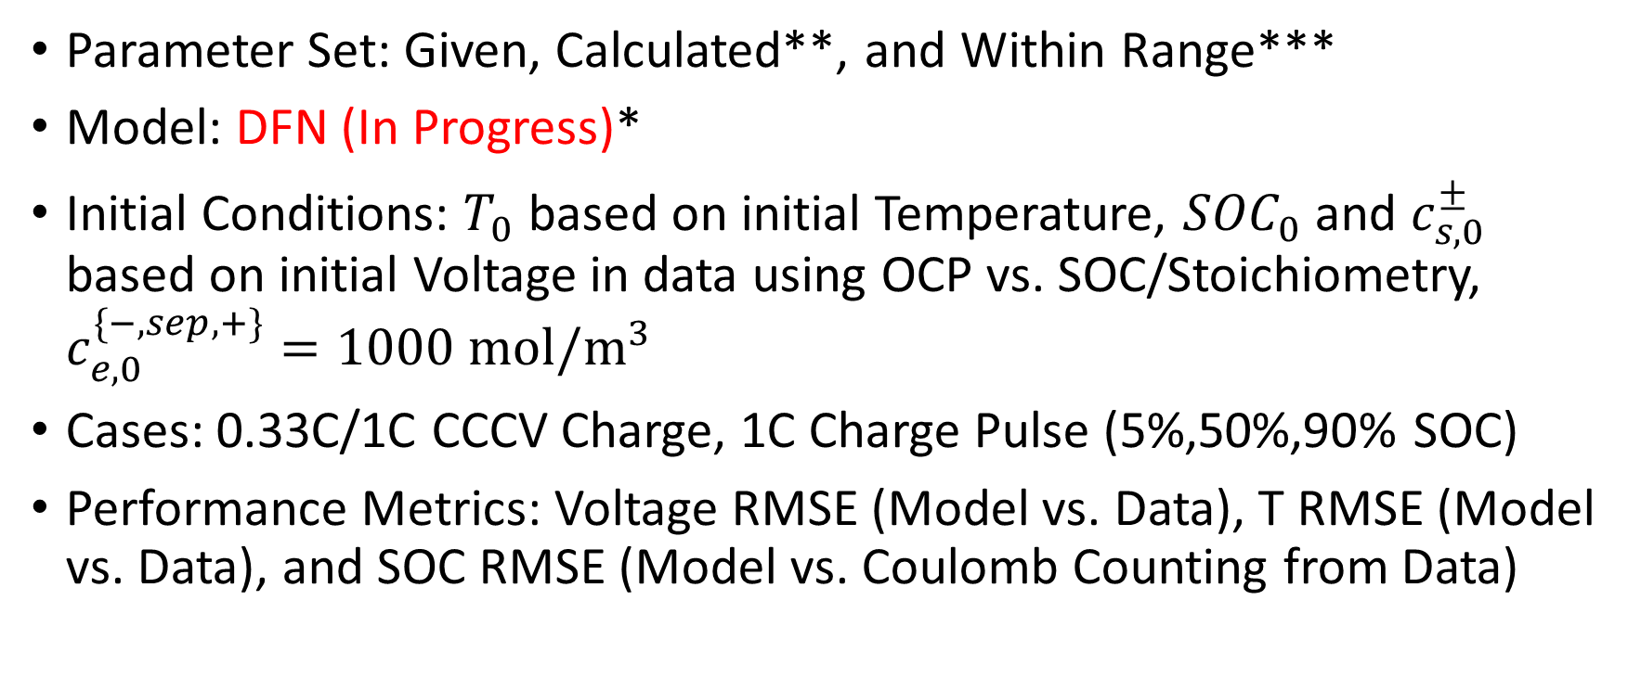
Full Order Model Validation* – LGC Parameters
Parameter Set: Given, Calculated**, and Within Range***
Model: DFN (In Progress)*
Initial Conditions: $T_{0}$ based on initial Temperature, ${SOC}_{0}$ and $c_{s,0}^{±}$ based on initial Voltage in data using OCP vs. SOC/Stoichiometry, $c_{e,0}^{\{−,sep,+\}}=1000 mol/m^{3}$
Cases: 0.33C/1C CCCV Charge, 1C Charge Pulse (5%,50%,90% SOC)
Performance Metrics: Voltage RMSE (Model vs. Data), T RMSE (Model vs. Data), and SOC RMSE (Model vs. Coulomb Counting from Data)
* In Progress
**Calculated: ${η_{Li}}_{s},ε_{s}^{±}$
***Within Range: $ε_{e}^{±}, τ$ (electrolyte dynamics), $R_{th},T_{amb}$ (thermal dynamics)

Slide 16
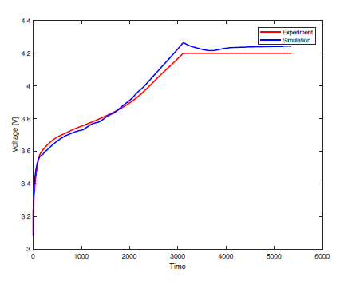
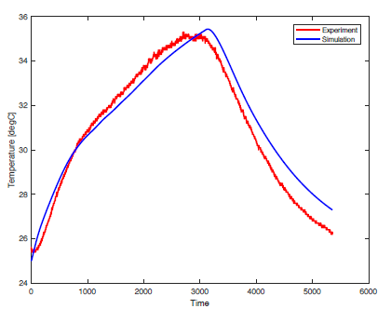
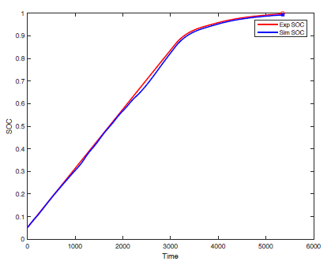
DFN Model Validation* – 1C CCCV Charge (25ºC) – LGC Parameters
*In Progress
RMSE_V=0.0331V, RMSE_T=0.72ºC
RMSE_SOC=9.3e-3 (0.93%)

Slide 17
Project Schedule

